Slide 1

AWS Lambda:
Revolutionizing Serverless Computing
Unleashing the power of event-driven architectures and empowering developers to build scalable, cost-effective applications.

Slide 2
What is AWS Lambda?
AWS Lambda is a groundbreaking serverless compute service provided by Amazon Web Services. At its core, Lambda allows you to run your code without needing to provision or manage any servers. This fundamentally changes how developers think about and deploy their applications, shifting the focus from infrastructure to pure application logic.
Fully Managed Service
Code Execution without Servers
AWS takes care of all the operational aspects, including server provisioning, patching, operating system maintenance, and capacity management. Developers no longer need to worry about the underlying infrastructure.
You simply upload your code, and Lambda executes it in a highly available and fault-tolerant environment. This "serverless" paradigm frees up valuable development time and resources.
Automatic Scaling
Pay-Per-Use Pricing
Lambda automatically scales your application by running multiple instances of your function concurrently to handle incoming requests, whether it's one per day or thousands per second.
One of Lambda's most compelling features is its cost model. You only pay for the compute time consumed by your code when it's actually running, measured in milliseconds, and the number of requests. There are no charges when your code isn't executing.

Slide 3
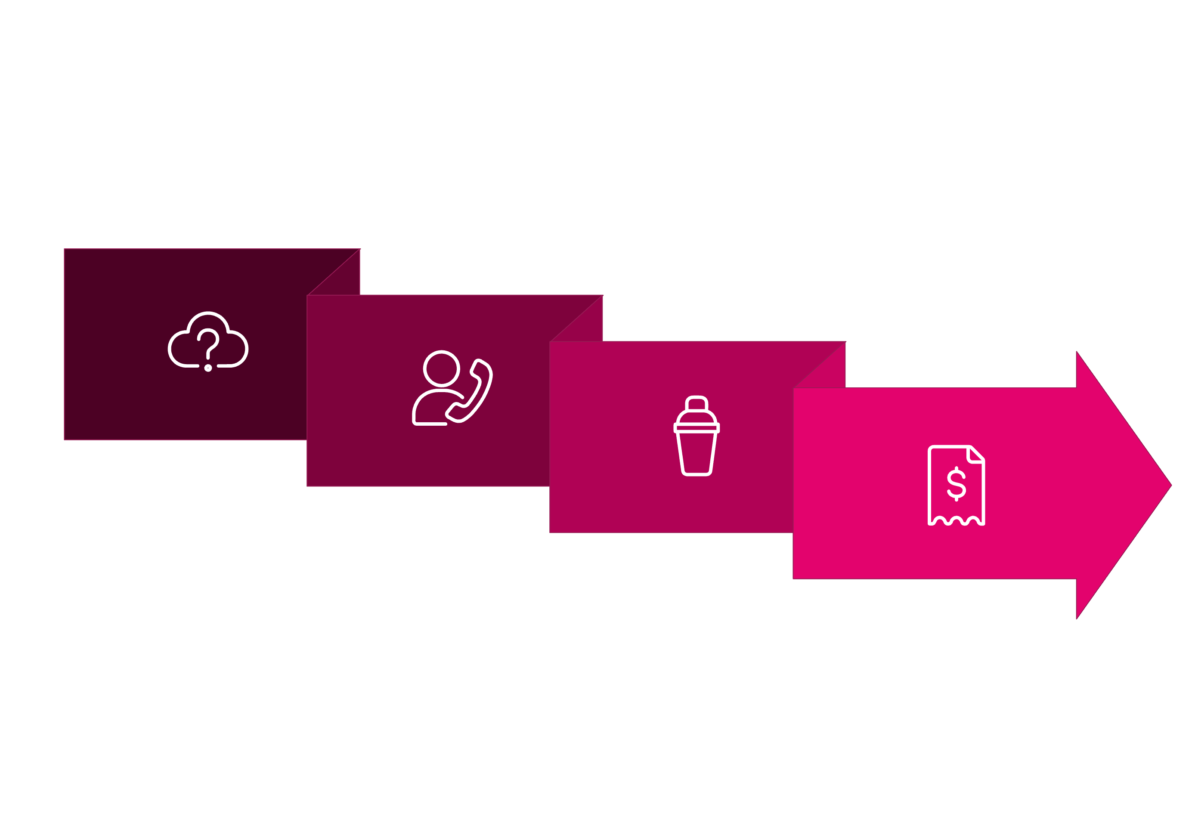




How AWS Lambda Works: Event-Driven & Serverless
AWS Lambda operates on an event-driven model, meaning your functions are executed only when a specific event occurs.
This makes it incredibly efficient and cost-effective for applications that respond to various triggers.
Invoke
Pay-per-ms
Trigger
Isolated Container
Lambda's architecture ensures that each function runs in its own isolated execution environment, often referred to as a "container." This isolation provides security and resource allocation guarantees. When an event triggers a function, Lambda allocates the necessary CPU and memory resources for that specific execution. Once the execution completes, the resources are released. This ephemeral nature is central to the serverless philosophy.
The pricing model, often called "pay-per-millisecond," is a significant advantage. You are billed based on the duration your code executes (rounded up to the nearest millisecond) and the amount of memory you configure for your function. This means you avoid the costs associated with idle servers or pre-provisioned capacity that might not always be fully utilized.

Slide 4
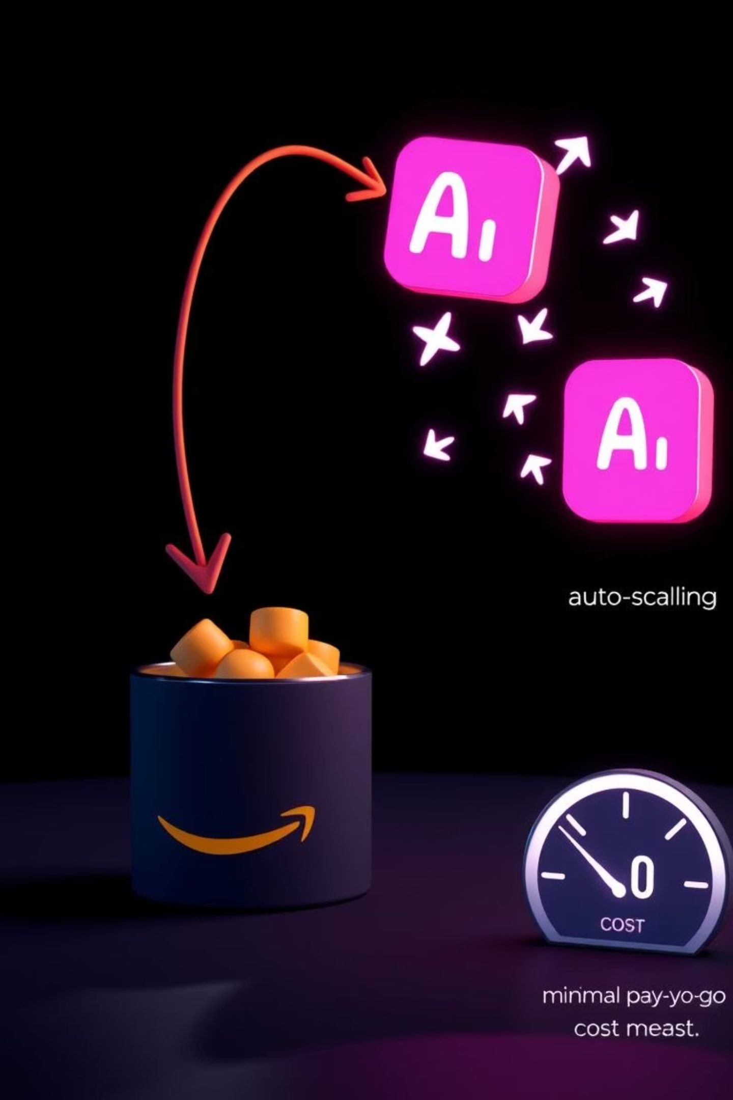
Event-Driven Architecture in Action
Imagine a scenario where a new file is uploaded to an Amazon S3 bucket. This action serves as an event that can automatically trigger an AWS Lambda function.
Upon receiving the trigger, the Lambda function springs into action. It could, for example, process the uploaded file: resize images, transcode videos, extract metadata, or even initiate data analysis. This entire process happens without you managing a single server.
The visual on the right illustrates this flow, showcasing the seamless connection between services, the instant scalability of Lambda to handle varying loads, and the highly cost-efficient pay-as-you-go model, only charging for the actual time your code runs. This model makes serverless computing incredibly attractive for unpredictable workloads.

Slide 5





Key Features That Empower Developers
AWS Lambda offers a rich set of features designed to enhance developer productivity and flexibility, allowing for robust and adaptable serverless application development.
Multi-Language Support
Versions & Aliases
Lambda Layers
Lambda supports a wide array of popular programming languages, including Python, Node.js, Java, C#, Go, PowerShell, and Ruby. This allows developers to use their preferred tools and expertise.
Manage different versions of your Lambda functions and use aliases to point to specific versions. This enables safe, controlled deployments, A/B testing, and easy rollbacks without downtime.
Package common dependencies, libraries, and custom runtimes into reusable layers. This reduces function deployment sizes, speeds up deployments, and promotes code reuse across multiple functions.
Container Image Support
Environment Variables & Extensions
For workloads with complex dependencies or machine learning models, Lambda allows you to package your function as a container image up to 10 GB. This provides greater control over the execution environment.
Customize your function's behavior with environment variables for configuration. Use Lambda Extensions to integrate with your favorite monitoring, observability, security, and governance tools.

Slide 6
Real-World Use Cases
AWS Lambda's versatility makes it suitable for a wide range of applications, from backend processing to real-time data analysis. Here are some prevalent scenarios where Lambda truly shines:
File Processing & Transformations
Web & Mobile Backends
Trigger Lambda functions automatically when new files are uploaded to Amazon S3. This is ideal for image resizing, video transcoding, data extraction, or generating thumbnails in real-time, eliminating the need for dedicated servers to handle these tasks.
Build highly scalable and secure APIs for web and mobile applications by combining Lambda with Amazon API Gateway. This provides a robust, serverless backend that automatically scales to handle millions of requests without managing servers.
IoT Backends
Stream Processing
Process telemetry data from millions of Internet of Things (IoT) devices seamlessly. Lambda can ingest, filter, transform, and route data from connected devices to other AWS services for analytics, storage, or real-time actions.
Integrate Lambda with Amazon Kinesis or Apache Kafka to process and analyze real-time data streams from various sources. This enables instantaneous insights from application logs, IoT sensor data, or financial transactions.

Slide 7




Why Choose AWS Lambda? The Benefits
Adopting AWS Lambda brings a host of compelling advantages that can significantly impact development speed, operational efficiency, and cost management.
Zero Server Management
Instant Scaling & Elasticity
AWS completely handles the underlying infrastructure, operating system patches, security updates, and server capacity planning. This allows your teams to focus purely on application logic and delivering business value, rather than infrastructure maintenance.
Lambda functions can scale from zero to thousands of concurrent executions in milliseconds to meet demand spikes. You never have to over-provision or worry about sudden traffic surges. It handles the scaling automatically and transparently.
Unmatched Cost Efficiency
Built-in High Availability
With Lambda, you only pay for the actual compute time consumed by your code, measured in milliseconds. There are no charges for idle servers or pre-purchased capacity. This granular billing model often leads to significant cost savings compared to traditional server models.
Lambda automatically runs your code across multiple Availability Zones within an AWS Region, providing inherent fault tolerance and high availability. This built-in redundancy ensures your applications remain resilient even in the face of outages.

Slide 8



Performance & Scaling Controls
While Lambda offers automatic scaling, it also provides advanced controls to fine-tune performance and manage how your functions behave under load, ensuring optimal user experience.
Response Streaming
1
Improve the time-to-first-byte (TTFB) for large payloads by streaming responses back to clients as soon as they are available, rather than waiting for the entire function execution to complete.
Fine-Grained Concurrency Limits
2
Set specific concurrency limits for individual functions to prevent them from consuming too many resources or to protect downstream services from being overwhelmed during peak loads.
Provisioned Concurrency
3
Configure a pre-initialized amount of execution environments for your functions to be ready to respond instantly. This eliminates "cold starts" and provides predictable, low-latency performance for critical workloads.

Slide 9
Integration & Ecosystem Power
The true strength of AWS Lambda lies in its deep and seamless integration with a vast array of other AWS services, enabling the creation of powerful, modular, and resilient serverless architectures.
This interconnected ecosystem allows developers to effortlessly combine Lambda with databases like DynamoDB for data storage, S3 for object storage, API Gateway for building RESTful APIs, and orchestration services like AWS Step Functions for complex workflows. Message queuing with SQS and notifications with SNS further extend its capabilities.
Furthermore, the extensive support for Infrastructure as Code (IaC) tools, particularly AWS Cloud Development Kit (CDK), allows developers to define their entire serverless applications using familiar programming languages. This automates deployments, ensures consistency, and enables version control of your infrastructure alongside your code.

Slide 10

The Future is Serverless
With AWS Lambda
Embrace the serverless revolution and transform how you build and scale applications.
Empower your teams to innovate faster by eliminating infrastructure overhead.
Optimize costs with a pay-per-millisecond model, only paying for what you use.
Scale effortlessly to meet unpredictable demand, from zero to millions of invocations.
Focus on building impactful, differentiated applications, not managing servers.
Start your serverless journey today and unlock new possibilities!

